Slide 1
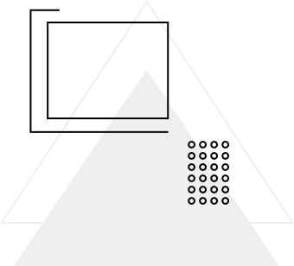
CH510L Machine Learning Project
CLASSIFICATION OF RICE GRAIN SPECIES USING MORPHOLOGICAL FEATURES
A Study of Cammeo and Osmancik Rice Grains
Vaibhav Mishra

Slide 2

PROBLEM STATEMENT
Problem Statement:
Rice species classification is crucial in the agriculture and food industry to ensure quality control and species identification.
Objective:
Classify rice grains into Cammeo and Osmancik species using morphological features extracted from grain images.

Slide 3
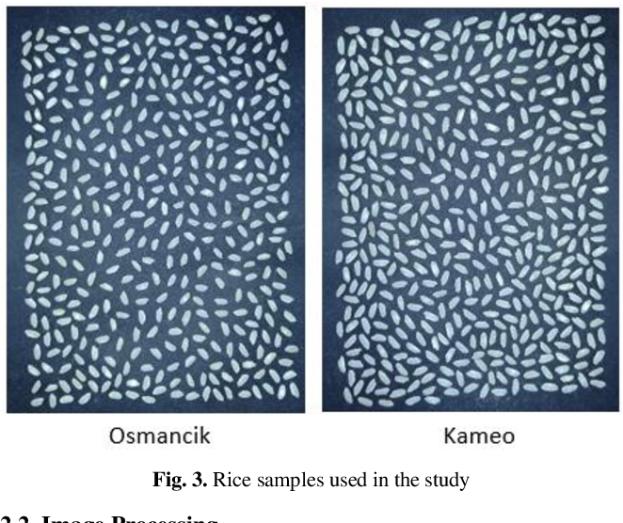
DATASET DESCRIPTION
Dataset:
3810 rice grain samples with 7 morphological features.
Features:
Area
Perimeter
Major Axis Length
Minor Axis Length
Eccentricity
Convex Area
Extent
Target Variable:
Class (Cammeo, Osmancik)

Slide 4
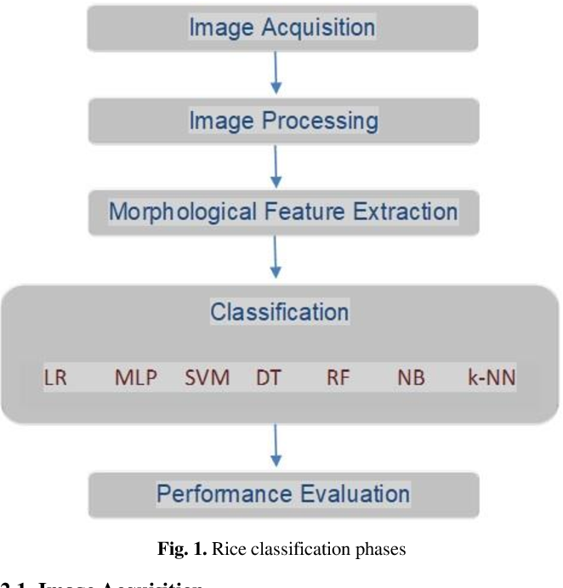
METHODOLOGY
1. Data Preprocessing
Encoded the target variable (Class).
Scaled the features using StandardScaler.
2. Model Implementation
Trained and evaluated seven classification models:
Logistic Regression
Support Vector Machine (SVM)
Decision Tree
Random Forest
Gradient Boosting
KNN
Neural Network
3. Feature Importance
Used Random Forest and Recursive Feature Elimination (RFE).
4. Hyperparameter Tuning
Optimized models using GridSearchCV.

Slide 5
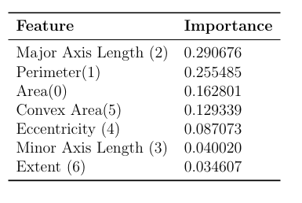
FEATURE IMPORTANCE
Key Results:
Most Important Features:
’Area’,
’Perimeter’
’Major Axis Length

Slide 6
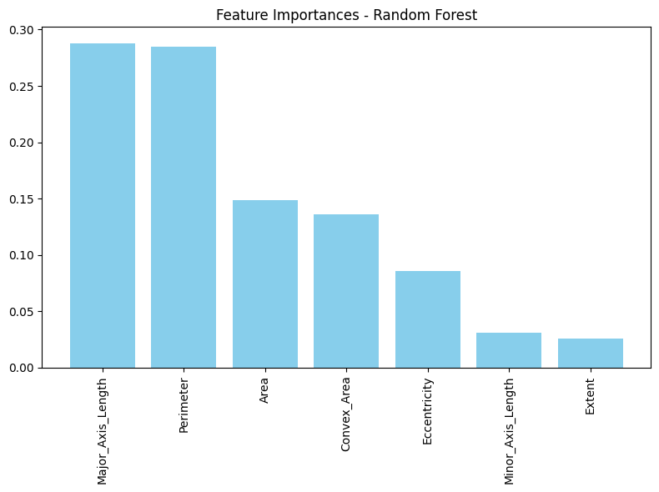
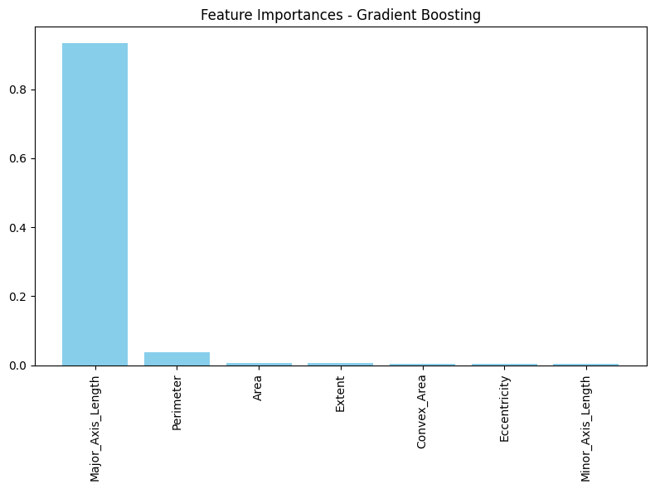
FEATURE IMPORTANCE

Slide 7
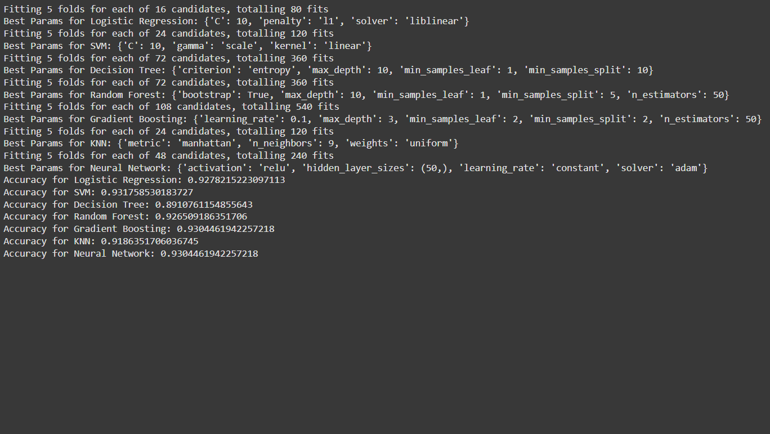
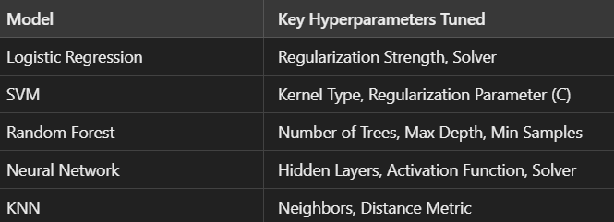
HYPERPARAMETER TUNING
Objective:
Optimize model parameters to enhance performance.
Techniques Used:
GridSearchCV
RandomizedSearchCV

Slide 8
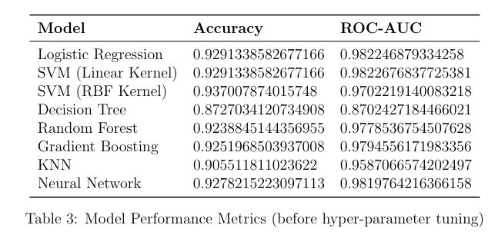
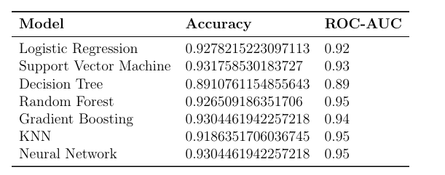
MODEL EVALUATION
Performance Metrics:
Accuracy
Confusion Matrix
ROC-AUC Curve
Table : Model evaluation before hyperparameter tuning
Table : Model evaluation after hyperparameter tuning

Slide 9
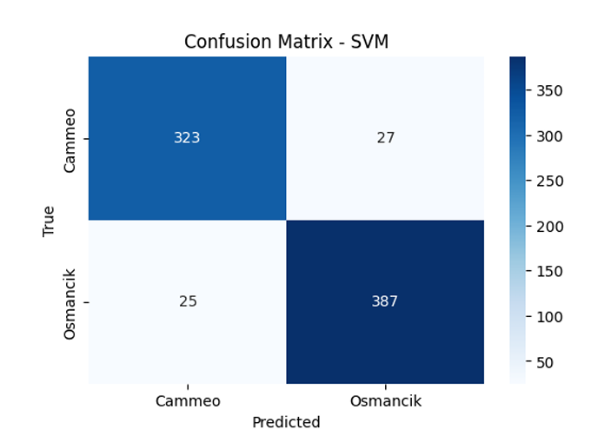
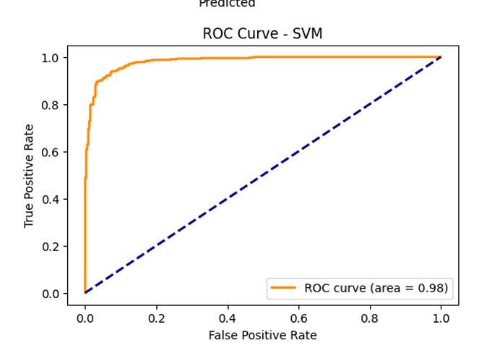
VISUALIZATIONS
For SVM (best performing model for our case)

Slide 10
CONCLUSION
Best Model:
The Support Vector Machines outperformed others in terms of both accuracy (93.7%) and ROC-AUC (0.97)..
Key Findings:
Morphological features like Area, Perimeter, Major Axis Length were found to be the most important. are critical for classification.
Hyperparameter tuning improved model performance did not improved the model accuracy by a greater margin, but a slight change.
Future Work:
Experiment with more advanced models (e.g., XGBoost).
Include additional morphological or texture-based features.

Slide 11
THANK YOU
Questions?

